Slide 1
Effective scientific communication
How to do data visualisation in an effective way

Slide 2
Why visualise?
Treatments | Mean x | Mean y | Std dev x | Std dev y | Corr(x,y)
A | 54.3 | 47.8 | 16.8 | 26.9 | -0.1
B | 54.3 | 47.8 | 16.8 | 26.9 | -0.1
C | 54.3 | 47.8 | 16.8 | 26.9 | -0.1
D | 54.3 | 47.8 | 16.8 | 26.9 | -0.1
E | 54.3 | 47.8 | 16.8 | 26.9 | -0.1
F | 54.3 | 47.8 | 16.8 | 26.9 | -0.1
G | 54.3 | 47.8 | 16.8 | 26.9 | -0.1
H | 54.3 | 47.8 | 16.8 | 26.9 | -0.1
I | 54.3 | 47.8 | 16.8 | 26.9 | -0.1
J | 54.3 | 47.8 | 16.8 | 26.9 | -0.1
K | 54.3 | 47.8 | 16.8 | 26.9 | -0.1
L | 54.3 | 47.8 | 16.8 | 26.9 | -0.1
M | 54.3 | 47.8 | 16.8 | 26.9 | -0.1
13 datasets from different “treatments”
If your hypothesis was:
  “There is no difference between these treatments”
  Would you reject or accept?

Slide 3
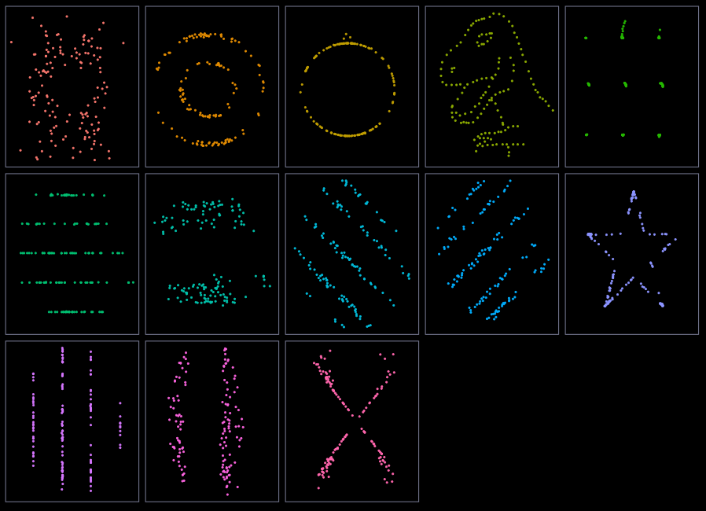
Why visualise?
Treatments | Mean x | Mean y | Std dev x | Std dev y | Corr(x,y)
A | 54.3 | 47.8 | 16.8 | 26.9 | -0.1
B | 54.3 | 47.8 | 16.8 | 26.9 | -0.1
C | 54.3 | 47.8 | 16.8 | 26.9 | -0.1
D | 54.3 | 47.8 | 16.8 | 26.9 | -0.1
E | 54.3 | 47.8 | 16.8 | 26.9 | -0.1
F | 54.3 | 47.8 | 16.8 | 26.9 | -0.1
G | 54.3 | 47.8 | 16.8 | 26.9 | -0.1
H | 54.3 | 47.8 | 16.8 | 26.9 | -0.1
I | 54.3 | 47.8 | 16.8 | 26.9 | -0.1
J | 54.3 | 47.8 | 16.8 | 26.9 | -0.1
K | 54.3 | 47.8 | 16.8 | 26.9 | -0.1
L | 54.3 | 47.8 | 16.8 | 26.9 | -0.1
M | 54.3 | 47.8 | 16.8 | 26.9 | -0.1

Slide 4
Why visualise?
Calculating summary statistics is great
But not sufficient
Summary stats (e.g. means) obscures a lot of information
Visualisations (normally) don’t

Slide 5
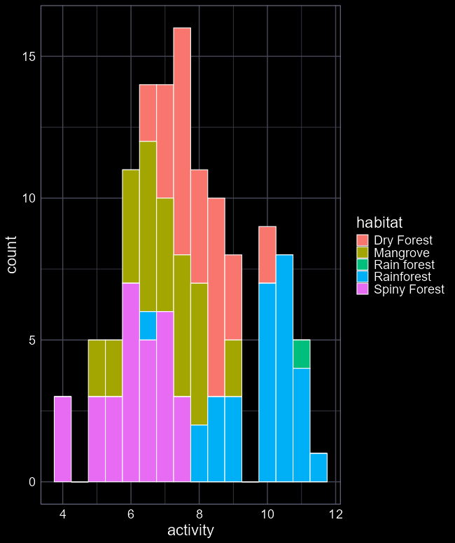
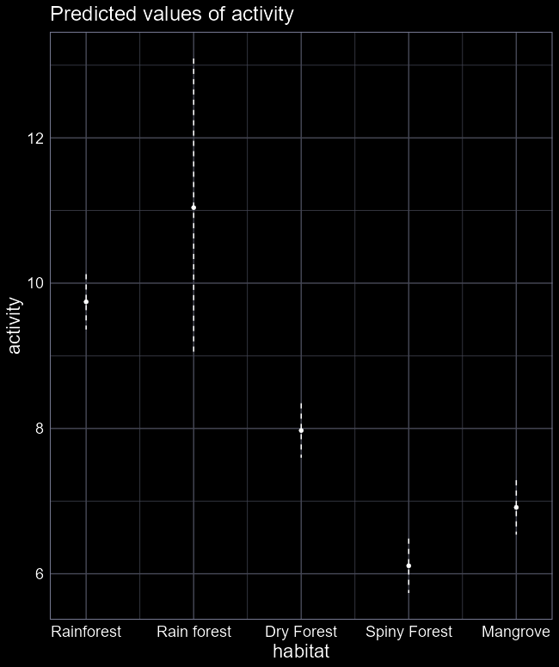
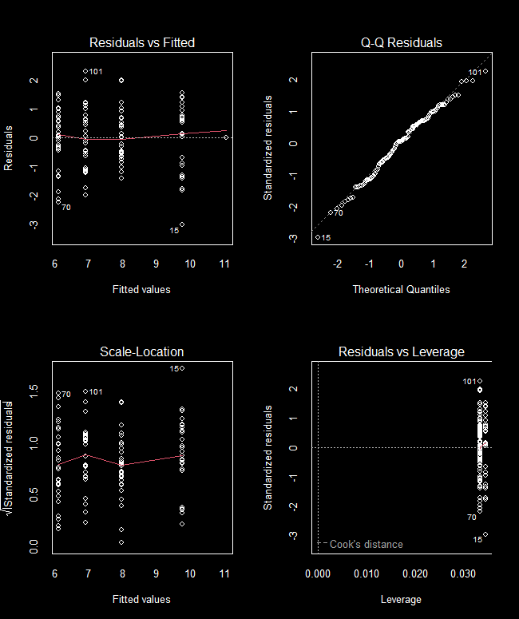
3 uses of graphics
“Exploratory analysis”
  Goal is to see things you did not expect or even know to look for
Summarising fitted models
  Convince yourself that your model warrants your trust
Presenting results
  Communicate your results to a broad audience to understand big picture

Slide 6
When visuals hide information

Slide 7
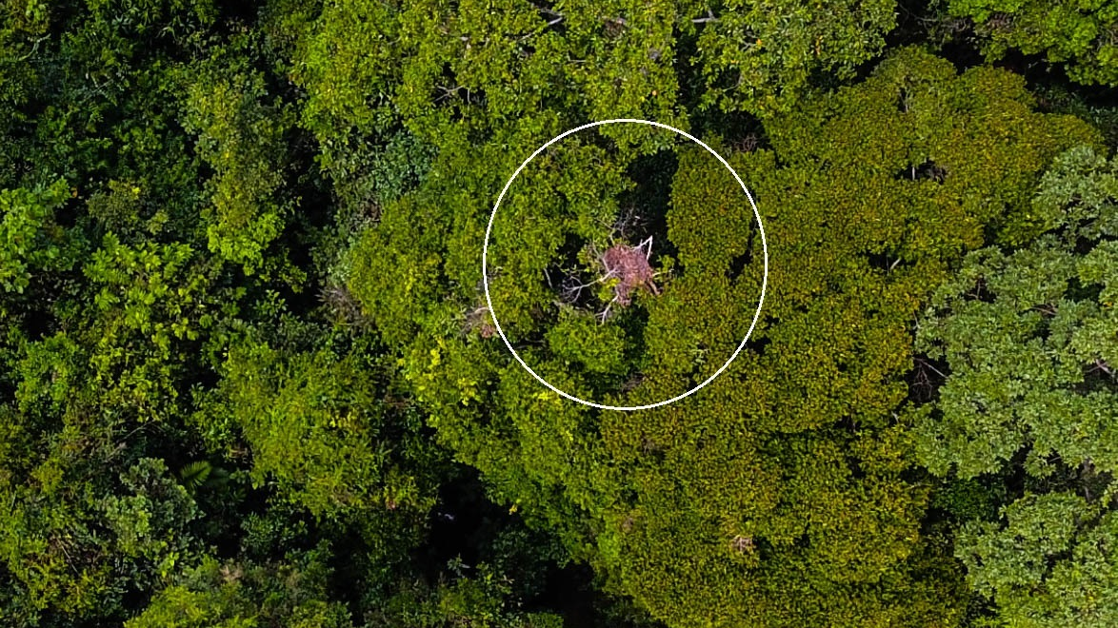
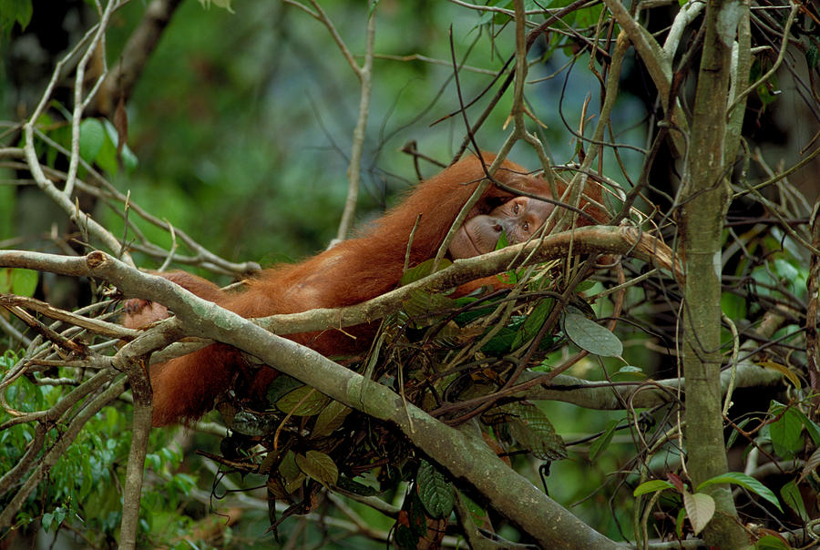

Slide 8
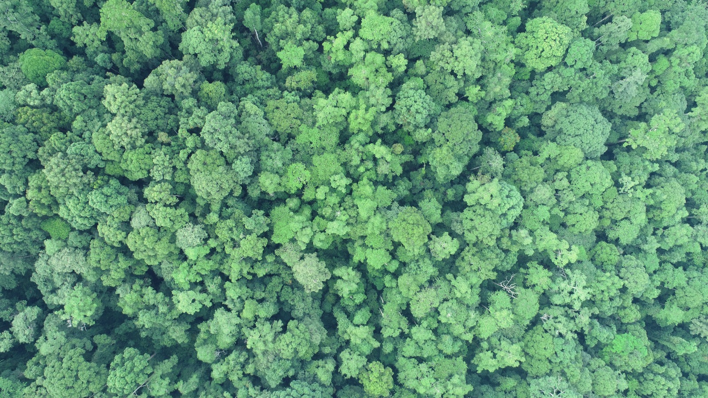

Slide 9
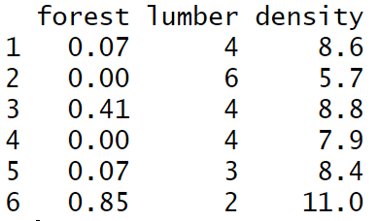
Our research question
How is percentage of old growth forest related to the density of orangutan nests in a 1 ha area?
Is there a relationship?
Is it worth going through the pain of doing statistics?

Slide 10
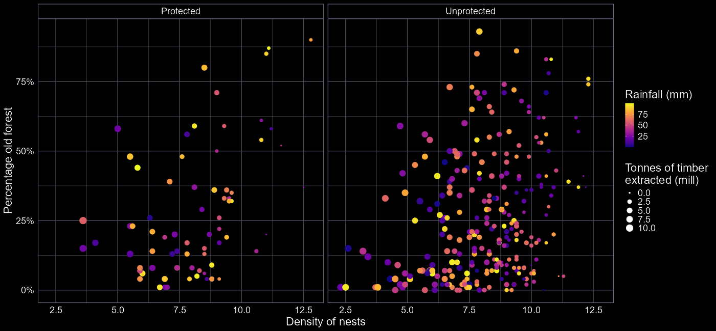
Is there a relationship?

Slide 11
Is there a relationship?
Does density of orangutan nests increase with percentage of old growth forest?

Slide 12
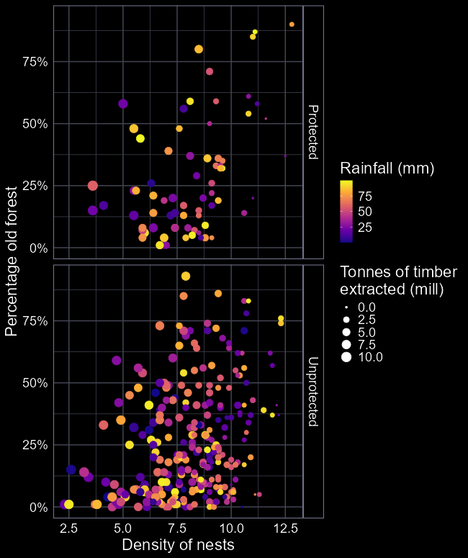
What’s wrong with this figure?
Axes are the wrong way around
Values of colours are hard to read
Size of points are hard to read
Facets add extra complexity
Ultimately, does a poor job of explaining the relationship we want it to explain

Slide 13
Optical illusions

Slide 14
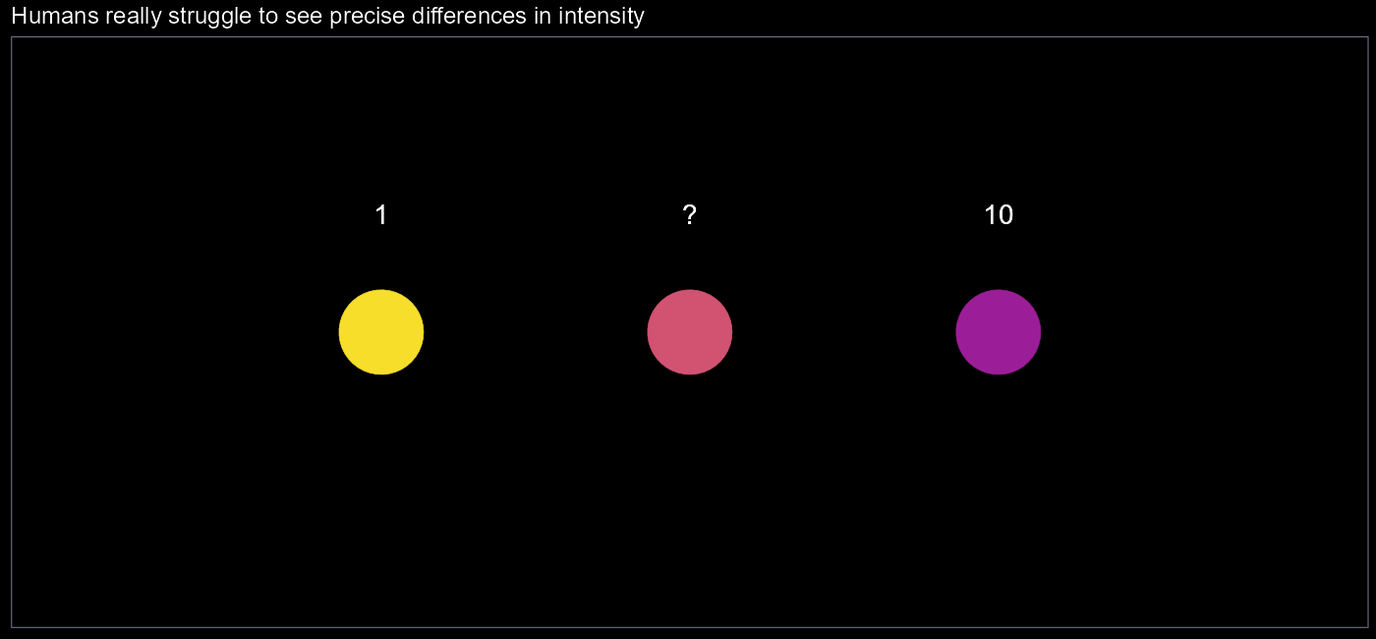

Slide 15
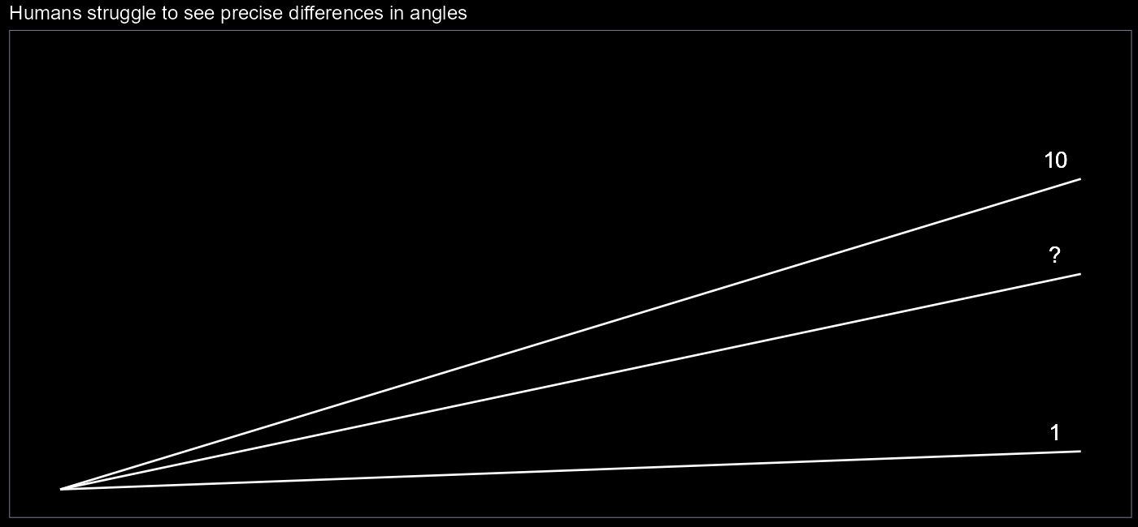

Slide 16
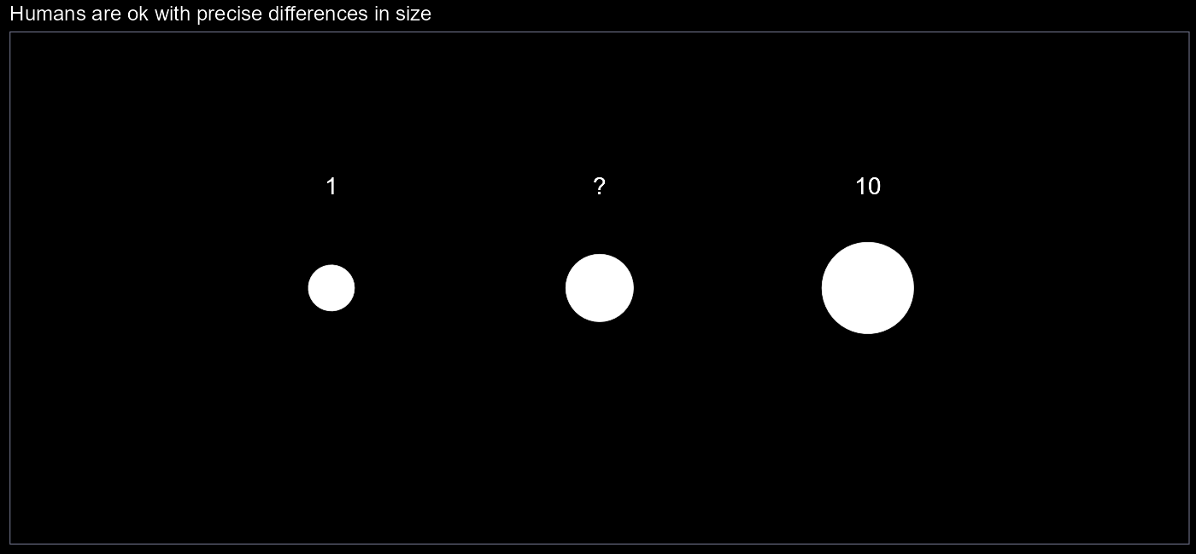

Slide 17
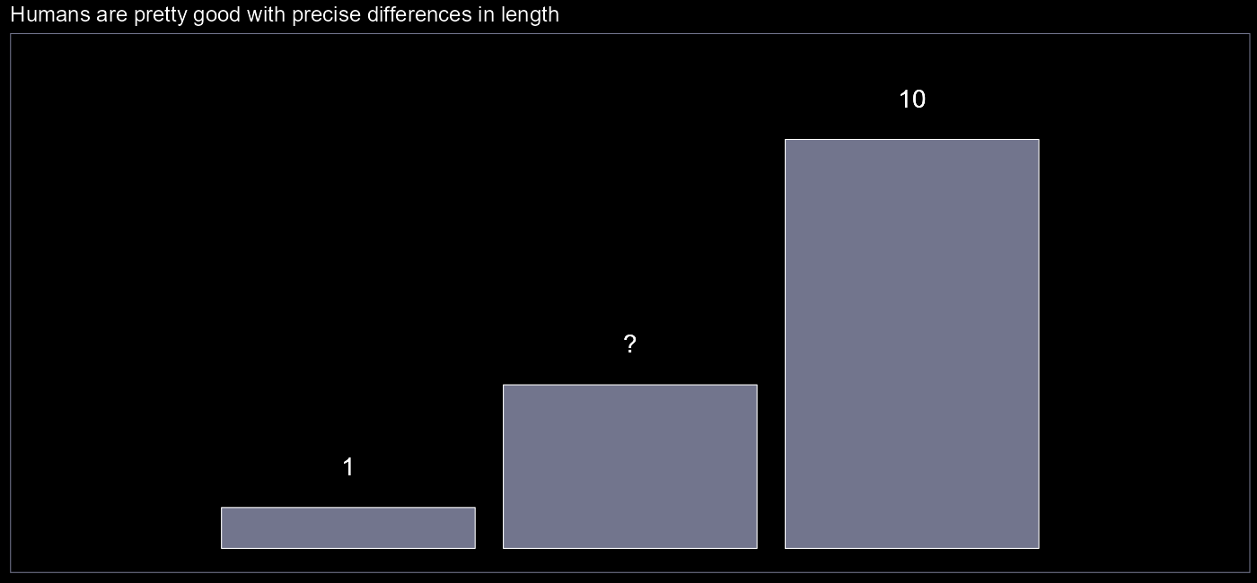

Slide 18
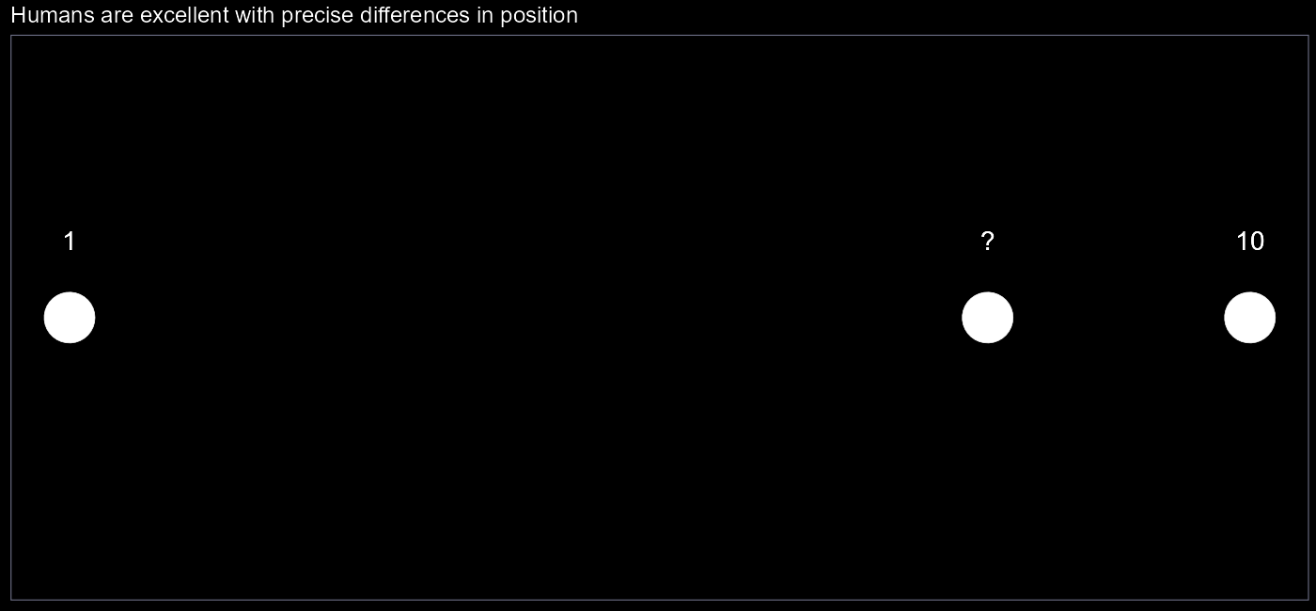

Slide 19
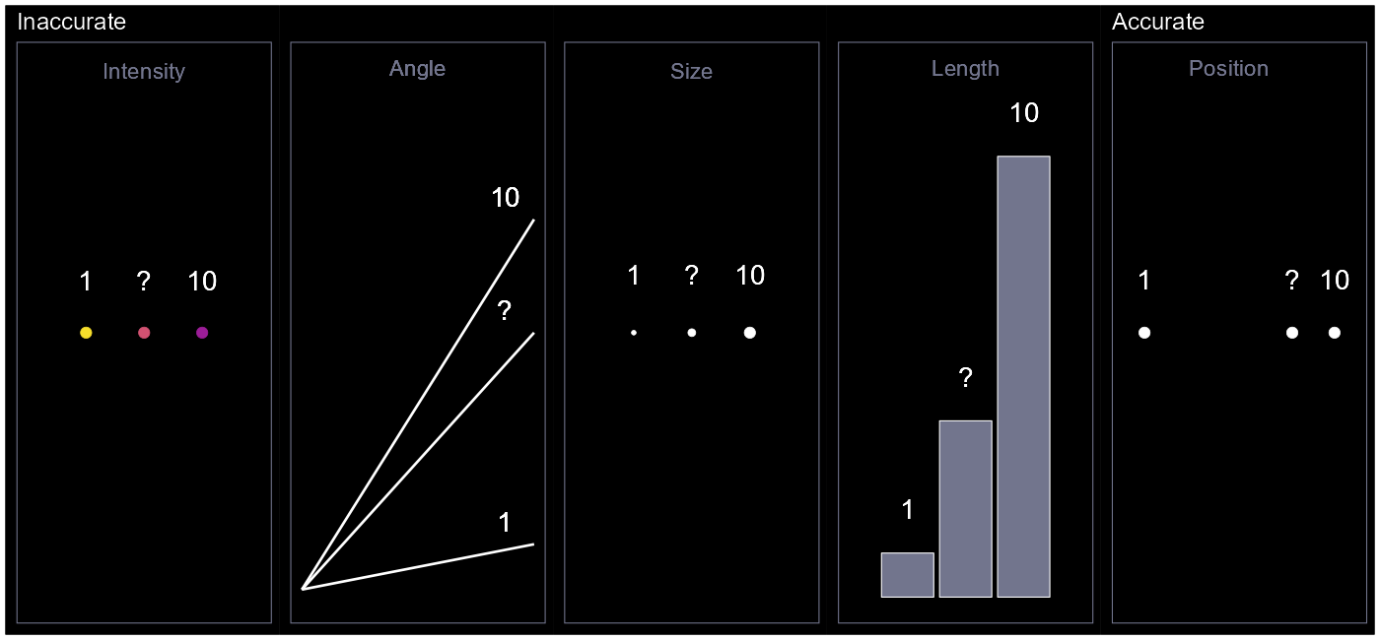





$$?=7$$
$$?=7$$
$$?=3$$
$$?=4$$
$$?=8$$

Slide 20
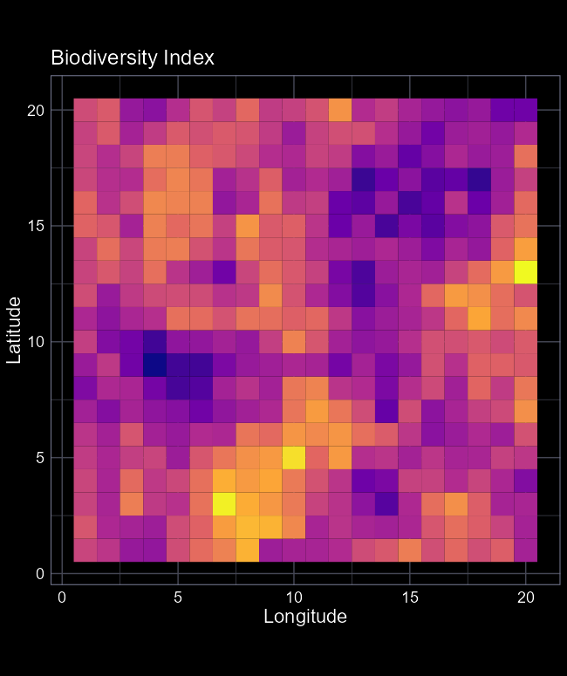
Guidance, not rules
None of the different ways to visualise are always wrong or always right
Depends on the context
Consider what you’re trying to do and use the most appropriate option

Slide 21
Where each fail in their own special way

Slide 22
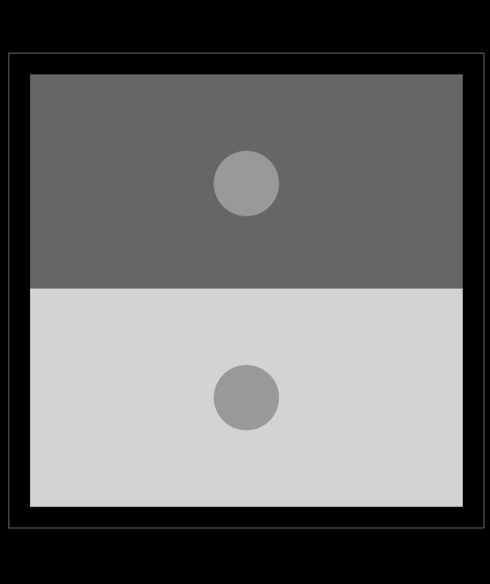
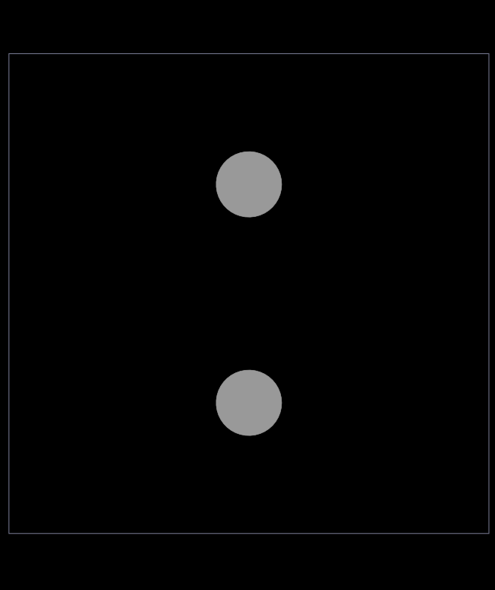
Intensity
The same intensity can look different if plotted on top of another layer of intensity
Avoid using multiple intensities

Slide 23
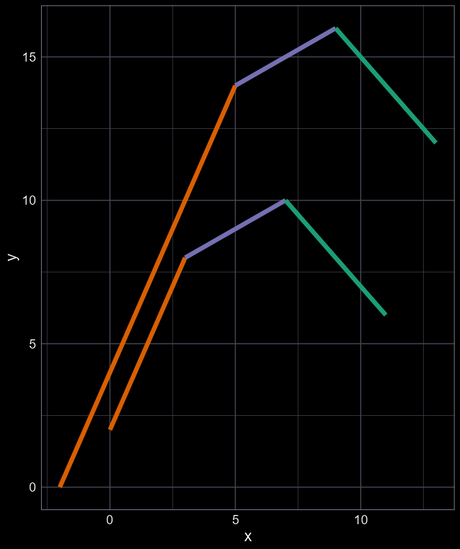
Angle
Are purple angles the same?
Comparing multiple angles can lead to optical illusion where identical angles appear different
All coloured line segments have the same angle

Slide 24
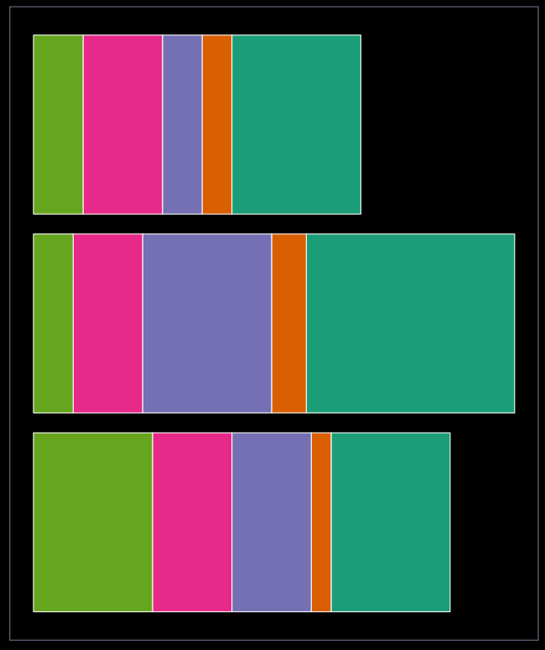
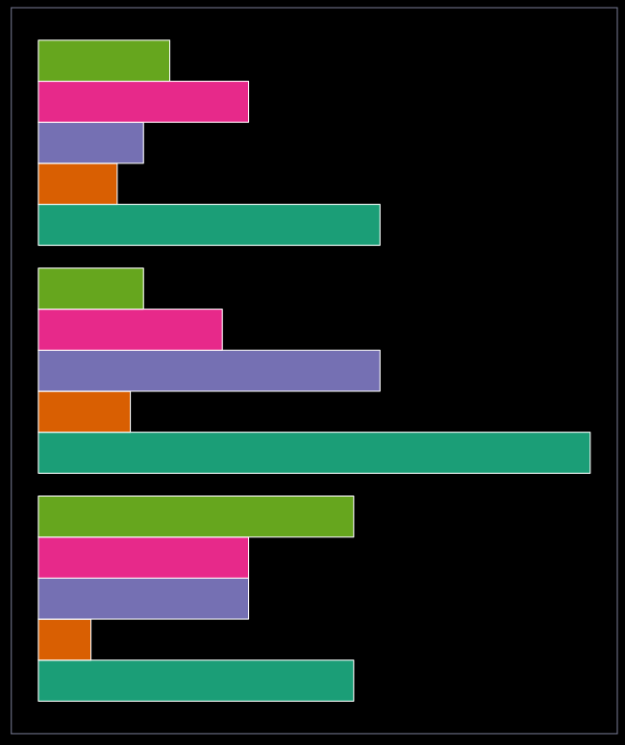
Length
Comparing baselines (puke green) are easy
Are any colour triplets, or pairs, the same?
But comparing other groups is hard (e.g. is orange in top and bottom bars the same?)
Avoid stacking bars on each other

Slide 25
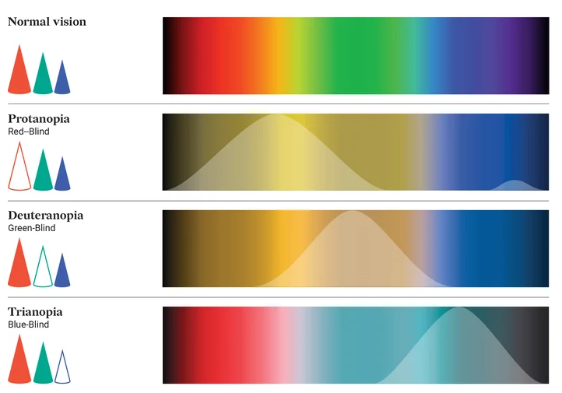
Colour blindness
Roughly 5% of humans are colourblind
Colours to avoid
  Red and green
  Red and blue
Really easy to use colour blind friendly colour palettes
palette.colors(palette = "Okabe-Ito")
This is now the default in R

Slide 26
Incorporate concepts

Slide 27
Let’s improve this

Slide 28
What’s should we change?
Response variable on the Y-axis
Reduce the amount of information we are asking the reader to process
  Always make life easy for your reader

Slide 29
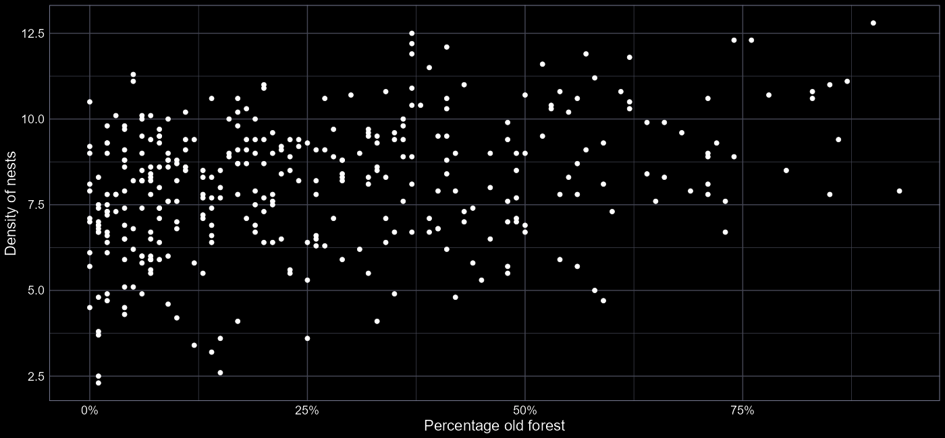
Our improved figure

Slide 30
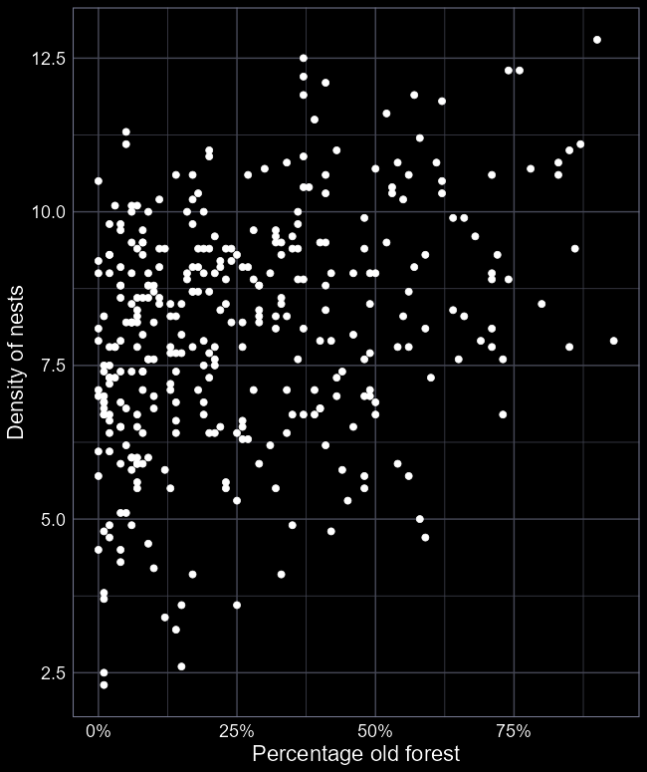
Effective visual communication
Primary objective is to keep the amount of information to an absolute minimum
The more your audience has to think, the less effective you are
KISS; “Keep it simple, stupid”

